Slide 1
CS 330 Case Study Part I
By Benjamin Schussheim, John Lee, Joey Nolan, Ezra Odio

Slide 2
Task 1 - Density Function
How do we pre-process our data?
First, we divide the map into squares of side length r. Then, we loop through all the points and, for each point, find what square it’s in and increment the value associated with that square by one. We do this by creating a 2d array that stores the point count for each square. We return this 2d array and a sorted version of the 2d array. The runtime for the pre-processing algorithm is O(nlogn) since we sort the 2d array at the end (where n is the number of squares in the grid).
What does the density function do?
The density function takes in a point p and radius r (this r value is the same as the one we use to pre-process our data). The function then determines which square from our pre-processing the point p falls into and returns the point count of this square. The time complexity of this function is O(1), as we return a specific value from the 2d array created during our pre-processing.
Why design density function with squares?
We decided to use a square around point p rather than a circle because we’re working with data from Beijing, which is laid out in a grid. Therefore, we felt that it’d be more beneficial to understand density in terms of squares rather than circles.
Example of density calculation:
p = points[10000]
#Point(date='2009-12-24 06:23:31', id='163-20091224024334', x=2.597577, y=3.440068)
density(p, r=2.)
#returns 1281

Slide 3
Task 1 - Hubs Procedure
What does the Hubs function do?
The hubs function takes in the list of points, the number of hubs (k), and the radius of the hubs (r). The hubs function then returns the coordinates of the center points of the k squares in our grid with the largest densities. The side length of each square in the grid computed during pre-processing is r, ensuring that the hubs do not overlap.
How long does the Hubs function take?
The time complexity of the hubs function is O(1) because we are returning the largest k (a constant) values in the sorted grid that is created during pre-processing.

Slide 4
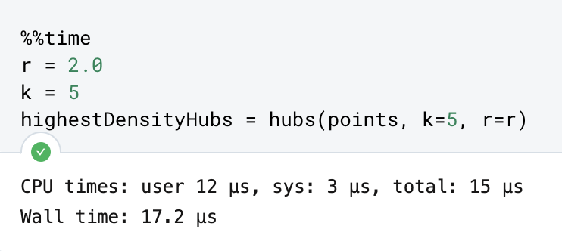
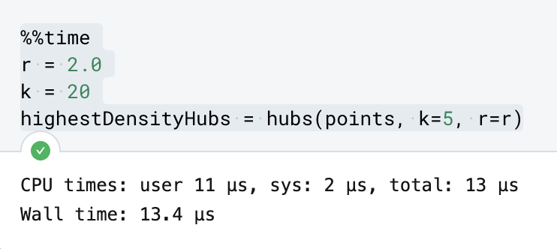
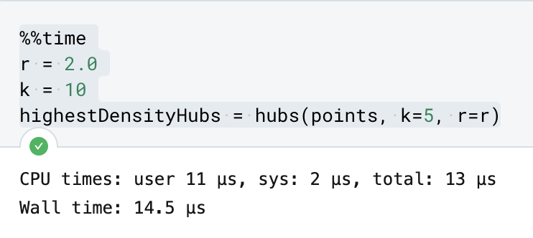
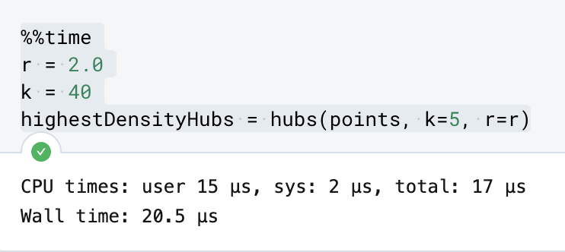
Task 1 - Experimental Results pt.1

Slide 5
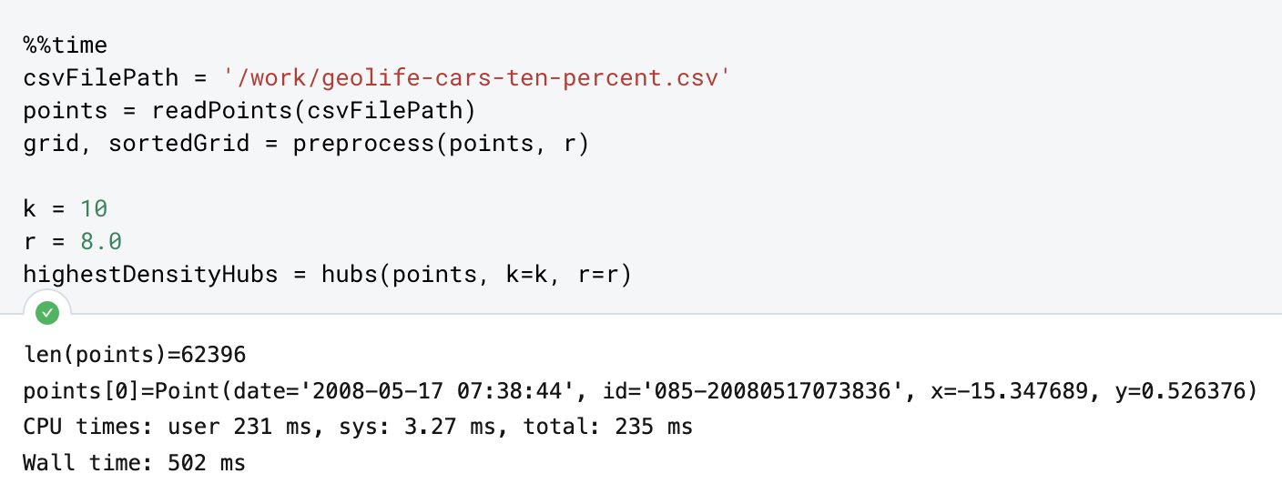
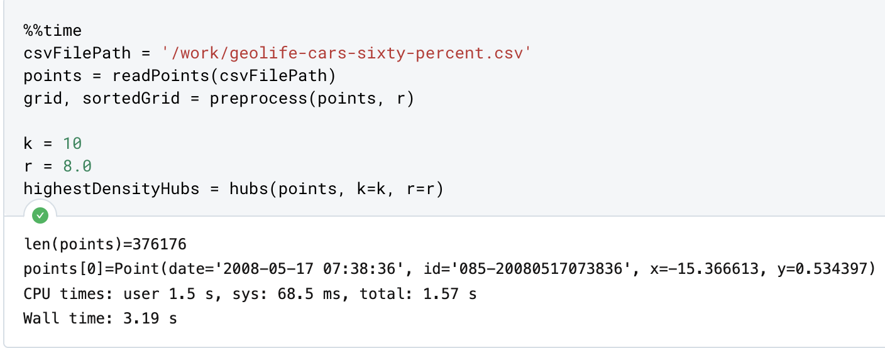
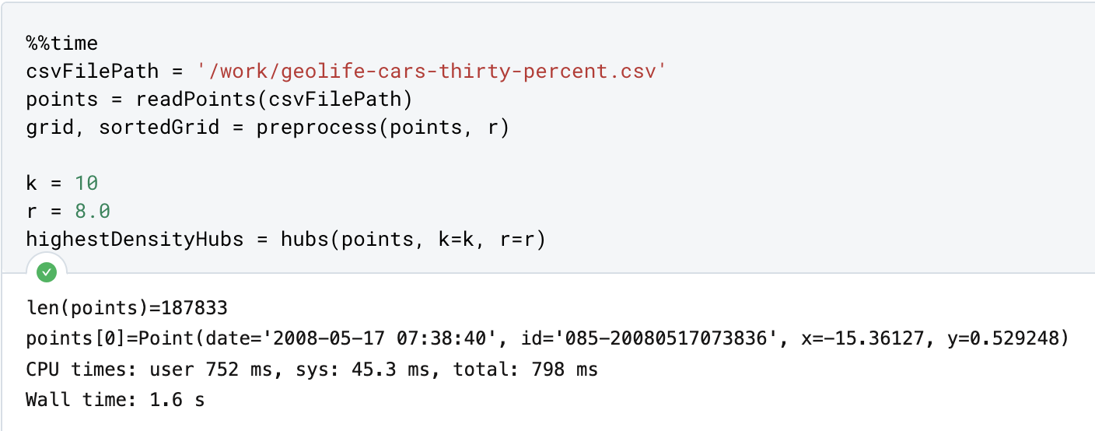
Task 1 - Experimental Results pt.2

Slide 6
Task 1 - Benefits and Drawbacks of Our Approach
Benefits
Our code runs in O(nlogn) time, so it runs efficiently on large amounts of data. This is useful because real-world trajectory data oftentimes contains lots of observations. Additionally, our code computes a reasonable solution as evidenced by our experimental trials.
Drawbacks
Because we optimized for efficiency rather than finding the best solution, there are likely better solutions than the one we find. If we were, say, building restaurants at each hub (or something else where we would be committing a lot of resources), we would likely opt for a more computationally-intensive algorithm to try and make sure our solution is as close to optimal as possible. Furthermore, it is possible that there will be many points far away from hubs. Depending on the use case, for example if we were building hospitals, this could be a problem.
Avenues for Future Improvements
We could add in a penalty for having data points that are really far from hubs. Depending on use case, this could be really important.
We could look more in-depth at high-density areas to determine optimal hub placement. This could allow us to potentially use fewer hubs in this area and save some hubs for other locations.

Slide 7
Task 2 - TS-greedy Algorithm
Algorithm Overview
The TS_greedy algorithm takes in a trajectory T, and an error ε, which is the maximum distance between a point on T and a line segment on the simplified trajectory T* supposed to be covering said point. The greedy algorithm draws the most basic simplification, a straight edge from the source to the end. Then, all distances from this edge to each point between the endpoints is computed. If the maximum distance in this list of distances is less than ε, a correct simplification has been found and the algorithm returns this edge. Otherwise, the algorithm takes this point which caused this max distance exceeding ε and uses it as a bound. The left sub-trajectory is recursed into with this same algorithm, bounded by the source and this point, while the right sub-trajectory is recursed into bounded by this point and the endpoint, essentially adding this point to the simplified trajectory. This is continued until the sub-trajectory is size 2, where no further simplification can happen, or the max distance is less than the error ε.
Runtime Complexity
The worst-case runtime complexity of the TS_greedy function is O(N^2). Finding the distances from an edge to each point runs in linear time and the worst-case would involve having to compare against each point in the trajectory, resulting in O(N^2). However, the trajectory is usually split in some way where the sub-trajectories are small enough of size (n/c), resulting in an overall runtime of O(n log n).

Slide 8
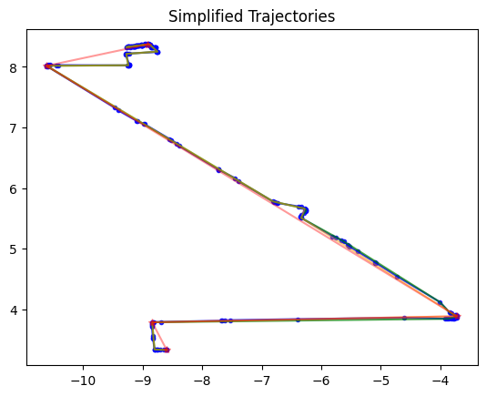
Task 2 - Experimental Results
Blue: Original Trajectory
Green: Least forgiving (0.03 error)
Orange: Medium forgiving (0.1 error)
Red: Most forgiving (0.3 error)

Slide 9
Task 2 - Experimental Results
Trajectory ID | Compression Ratio
128-20080503104400 | 17.83
010-20081016113953 | 49.36
115-20080520225850 | 30.93
115-20080615225707 | 30.04

Slide 10
Task 2 - Benefits and Drawbacks
Benefits
Our TS-greedy algorithm runs efficiently and finds a good trajectory simplification. This algorithm is very useful for large data sets, where slower runtimes will be significantly more expensive.
Drawbacks
Our TS-greedy algorithm does not provide the optimal trajectory simplification. If we had a lot of computing power and/or a smaller data set, we might want to use an algorithm with worse runtime to get better results. Additionally, the worst case of TS-greedy runtime is O(n²), so there are some edge cases where the algorithm might not be that efficient.
Avenues for Future Improvement
We could test a non greedy approach on different sized datasets to determine when less accuracy becomes acceptable for a better runtime.

Slide 11
Task 3 - ftw algorithm description
Initialize two tables, D(i,j) and E(i,j)
D(i,j) represents the minimum value of simga_avg of all the points up to index i of trajectory P and all the points up to index j of trajectory Q
E(i,j) represents |E| of the optimal assignments for sigma_avg in D(i,j)
Iterate through all cells and populate the tables according to the recurrence relations
D(i,j) = min( d1, d2, d3 )
d1 = (dist2(P[i], Q[j]) + D(i-1, j)) / (E(i-1, j) + 1)
d2 = (dist2(P[i], Q[j]) + D(i, j-1)) / (E(i, j-1) + 1)
d1 = (dist2(P[i], Q[j]) + D(i-1, j-1)) / (E(i-1, j-1) + 1)
E(i,j) = 1 + E(i*, j*) where i*, j* are the coordinates of of the minimum value cell for the computation for D(i,j)
Retrace the optimal solution and record the distances between each assignment pair
Return D(n-1, m-1) / E(n-1, m-1)

Slide 12
Task 3 - fd algorithm description
Initialize a table D(i,j)
D(i,j) represents the minimum value of sigma_max of all the points up to index i of trajectory P and all the points up to index j of trajectory Q
Iterate through all cells and populate the tables according to the recurrence relations
D(i,j) = min( d1, d2, d3 )
d1 = max(dist(P[i], Q[j]), D(i-1, j))
d2 = max(dist(P[i], Q[j]), D(i, j-1))
d3 = max(dist(P[i], Q[j]), D(i-1, j-1))
Retrace the optimal solution and record the distances between each assignment pair
Return D(n-1, m-1)

Slide 13
Task 3 - ftw and df runtime
Both algorithms run in O(nm) time and O(nm) space because either one or two tables of dimension n x m are being created. Then the algorithm iterates through each cell of the table and populates it with the recurrence relation.

Slide 14
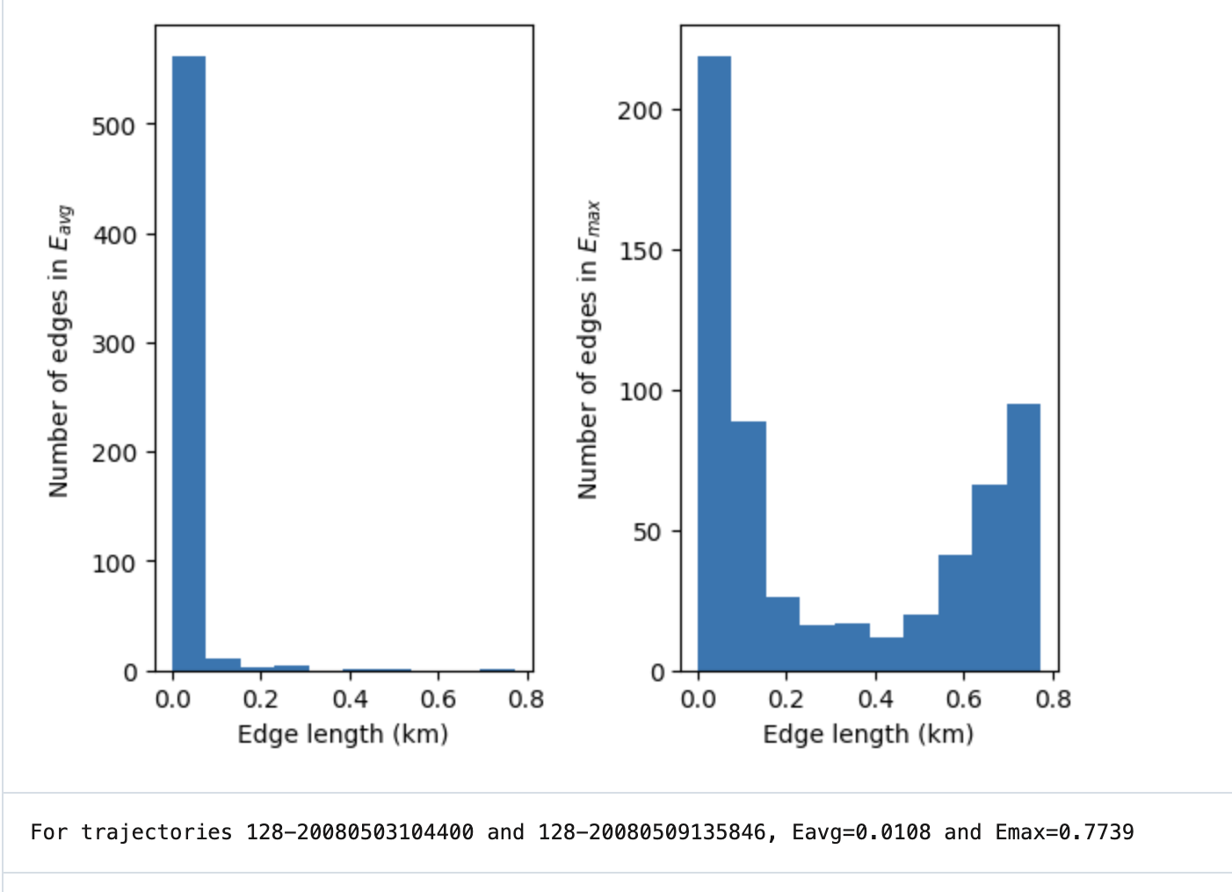
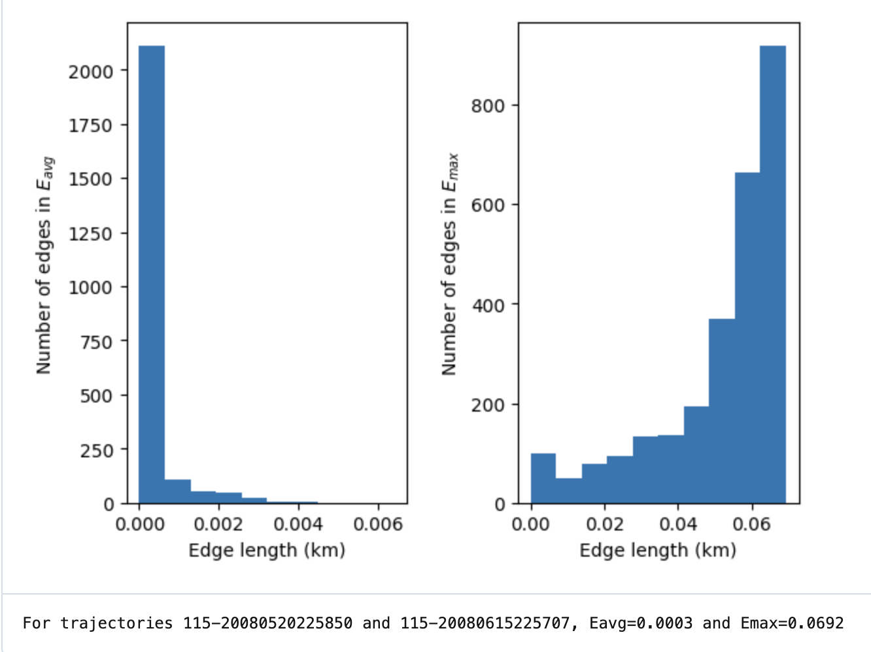
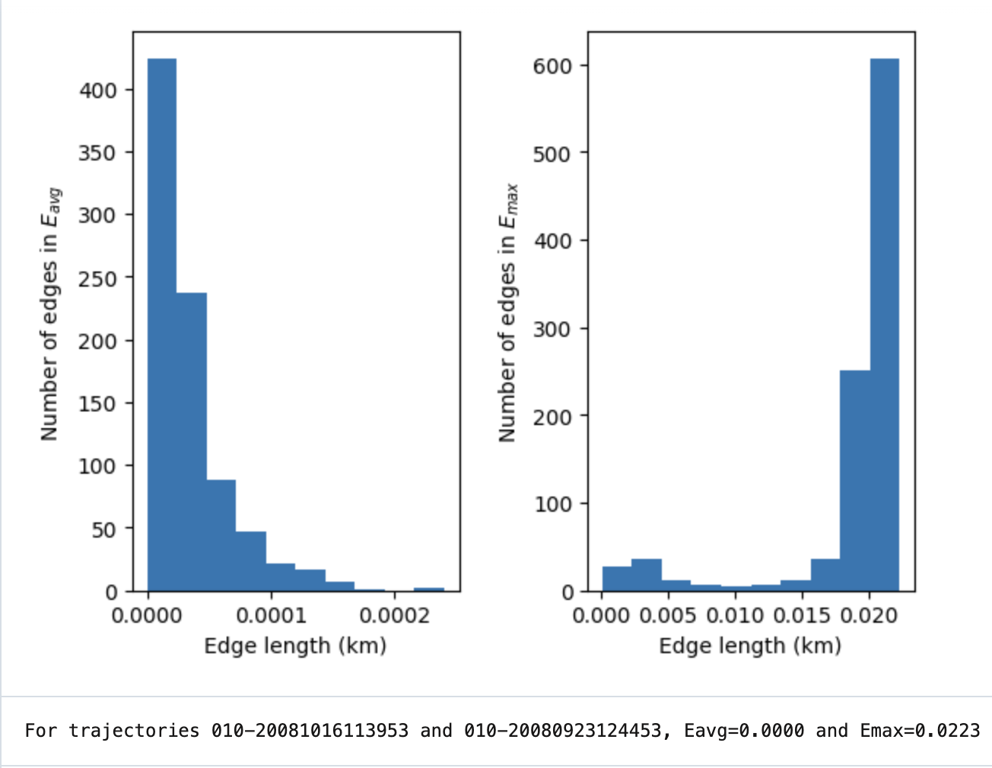
Task 3 - Original Trajectories Experimental Results

Slide 15
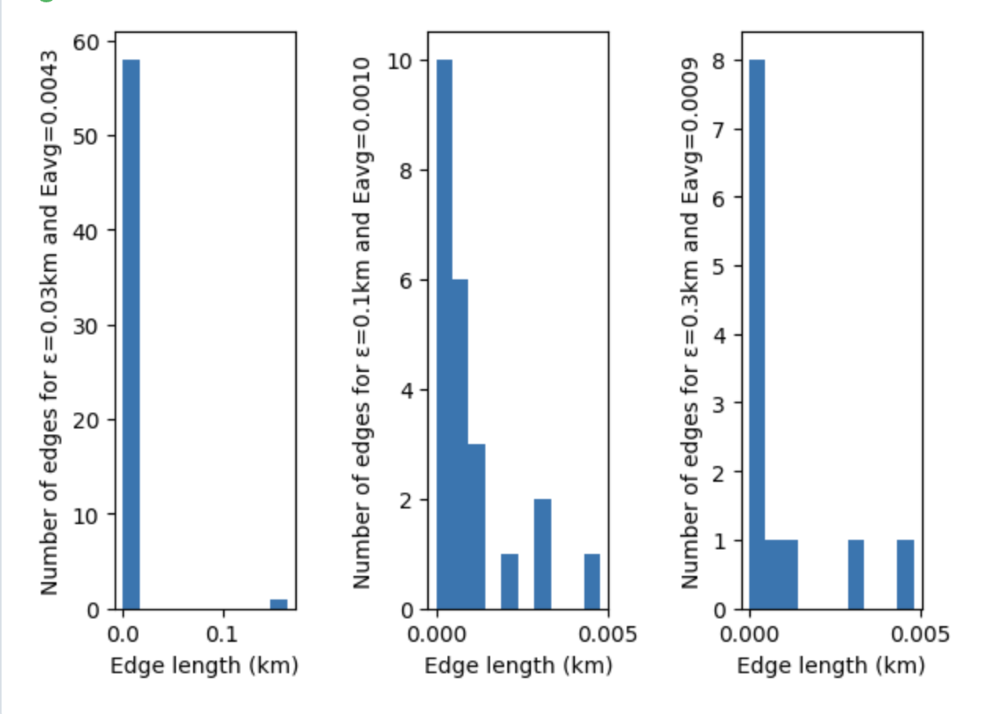
Task 3 - Simplified Trajectories Experimental Results

Slide 16
Task 3 - Benefits and Drawbacks
Benefits:
Efficient runtime for comparing small numbers of trajectories
Produces optimal result
Drawbacks:
Not feasible to compare the similarities of every pair of trajectories
Uses O(nm) space when the algorithm could be optimized to use O(min(m,n)) space for the forward pass

Slide 17
Group Member Contributions
Benji: Task 1 and 3, slides
Joey: Task 2, slides, code commenting, README
Ezra: Tasks 1 and 2, slides
John: Task 2 greedy algorithm (code, slides)

